Slide 1


AIBridge
Lecture 7
Notes:
Overfitting and feature selection

Slide 2
overfitting
Quality
Which one is a better line?
Acidity
Notes:
Let’s go back to the wine dataset. Here, the x-axis represents the acidity of the wine, and the y-axis represents the quality. You can kind of see a pattern already and that pattern probably looks something like this (click).
This line looks pretty accurate, but what’s stopping us from drawing a line that looks like this? (click) (pause).
So think for a moment (click), which of the two lines best represents these datapoints?
We will explain which line is better but also, what better even means.

Slide 3
overfitting
Quality
Acidity
this model has more predictive power
Notes:
Let’s focus on the green line. Let’s say a model approximated the relationship between acidity and quality to be this line. Although the line doesn’t pass through each datapoint perfectly, this line has more predictive power (click).
What does that mean? (click)
Here, we have a new data point. Let’s say this was another datapoint in the original dataset that was never shown to the model. When we compare the model’s prediction to the actual (click), we see that the error is very small.

Slide 4
overfitting
Quality
Acidity
this model is highly accurate on training data
but bad at predictions anywhere else
Notes:
Now, for the red line. Let’s assume, the model fits the dataset to this long, winding line. This model looks like it would do amazing, all of the datapoints are close to or maybe even on the line. So, we can say with confidence that this model is more accurate on the training data… but ONLY on the training data (click).
Let’s bring back our test data point. (click)
You can probably see the issue already, the error is significantly higher for this point (click) (click).
So, this means that although this model performs excellently on its training dataset, when we want to use it to predict anything other than the training set, it does poorly.

Slide 5

overfitting
Quality
overfit!
Acidity
too-precise fits to original data without generalization is called overfitting
Notes:
There’s a term for what happened to the red line and it’s called overfitting, which means the model fits to the original data TOO precisely and doesn’t generalize to the underlying patterns.
You can think of it like a student who memorizes all the answers to a test. Although they can pass it with near perfect accuracy, they do really badly on anything other than questions on that test specifically.
TAKE QUESTIONS

Slide 6
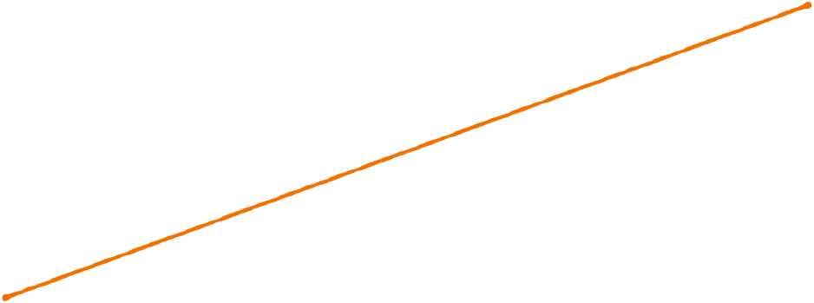

underfitting
degree 1
underfit!
model is unable to capture relationship between variables
Notes:
Let’s continue our discussion of overfitting by looking at a new scenario. Here are some new data points. Let’s fit a model to it. (click)
Usually, when we fit a model to a set of points, we can control the complexity of the line, which basically means how much it curves. This is through a number called the degree. (click)
This first line is probably what a model with a low degree—maybe a degree of one—would look like, and you can see that it’s not great. There’s a term for this: underfitting. (click)
Underfitting is when (click),
the model is simply just… bad. It doesn’t represent the training data and it probably won’t do any better when we run it on the testing data. This model needs a higher degree.

Slide 7
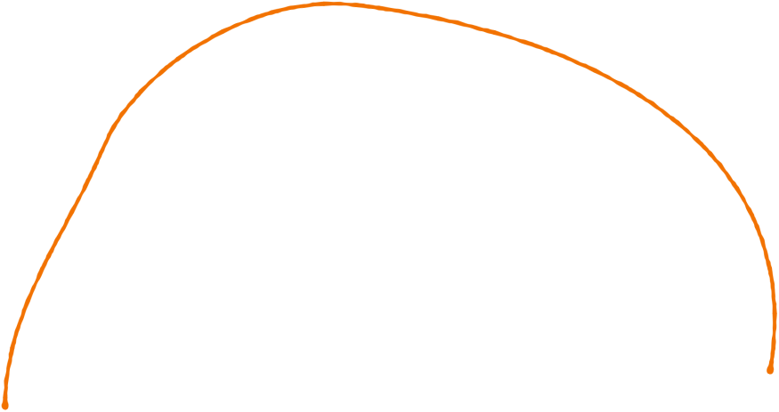
fitting
degree 2
Notes:
In this next training step, we can see the model is adapting its original line to more closely match the data.
(click) Its degree is probably 2 and it looks somewhat like a parabola.

Slide 8
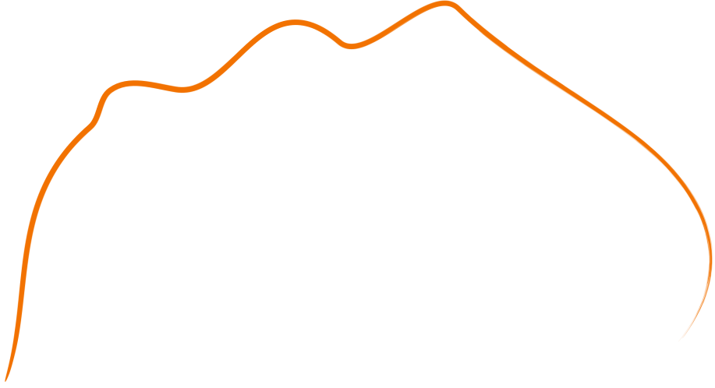
overfitting
degree 6
Notes:
With more degrees, the line gets even more complex, this is roughly what a line of degree 6 looks like.

Slide 9
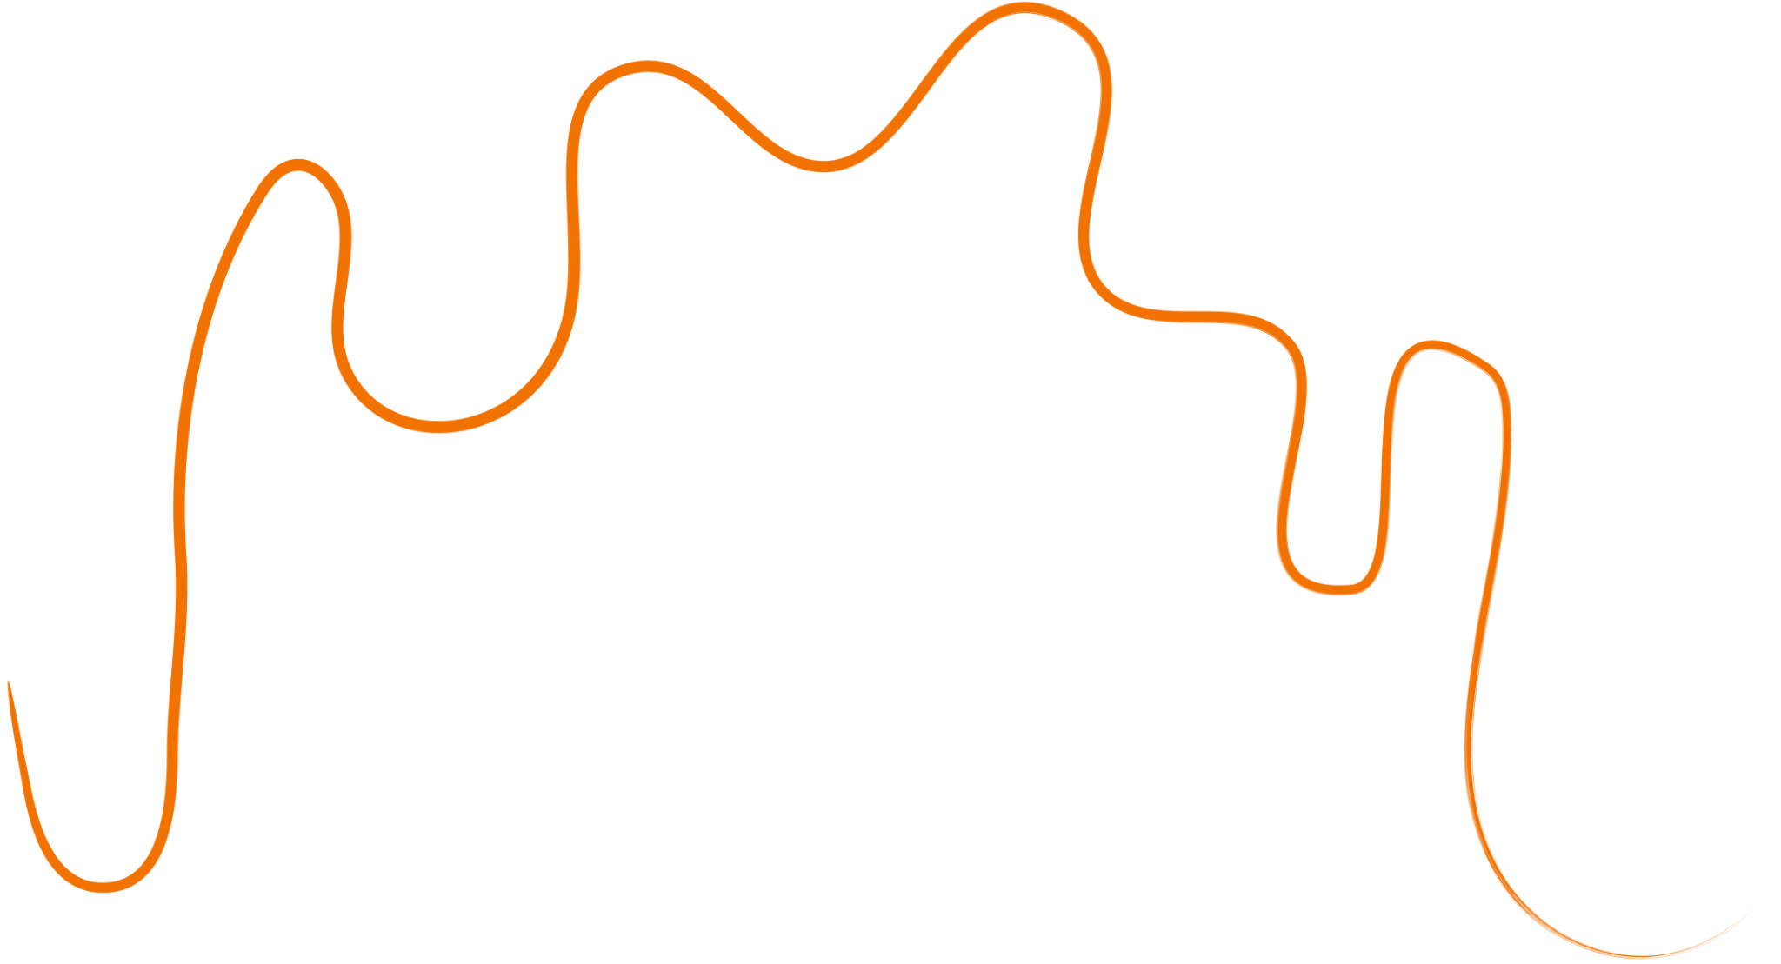
overfitting
degree 10
that’s overfit!
Notes:
Ok, we should stop here. (click), now it’s completely overfitting the data.
But just how bad is it? If you think back to the first few slides, we talked a bit about measuring the quality of a model. We can do this in a couple ways, I’m going to demonstrate one of these ways.
First, let’s add some data points it hasn’t seen before.

Slide 10
overfitting
Notes:
You can visually see how the line doesn’t really match up with the data points its never seen, so we can confidently say that this model is bad.
The line here completely memorized the training data it was training on, and it compensated too much for every data point. The result, is that there are a lot of cases where this model does very poorly because it was simply too complex for the task.
But how do we select the correct degree then? To explain, let’s first take a look at the other lines compared to the new points we just added.

Slide 11

underfitting
still not good
Notes:
This first line is still (click) not good, even with the other datapoints shown.

Slide 12
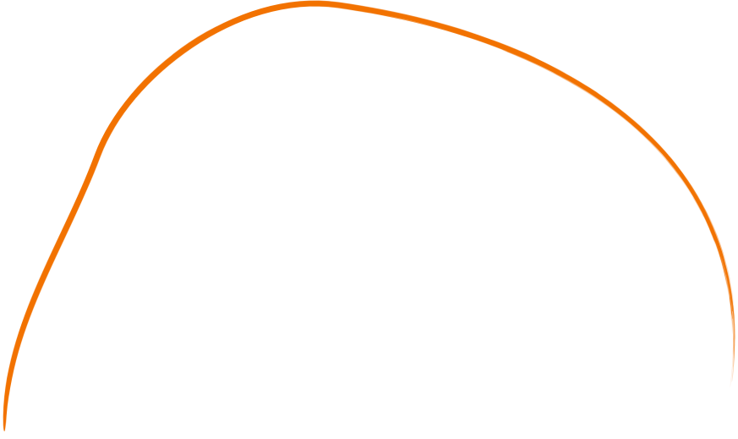
overfitting
Notes:
However, the second line is a lot better. It more closely follows the training points in black compared to the 1st line but not as much as the 4th one. In the case of this dataset, it also approximates the underlying pattern of the testing data pretty well too.
In this example, this curve with a degree of two would be perfect.
Lets see a side by side comparison of all the lines our model has predicted

Slide 13
overfitting
Notes:
HOLD! for transition

Slide 14


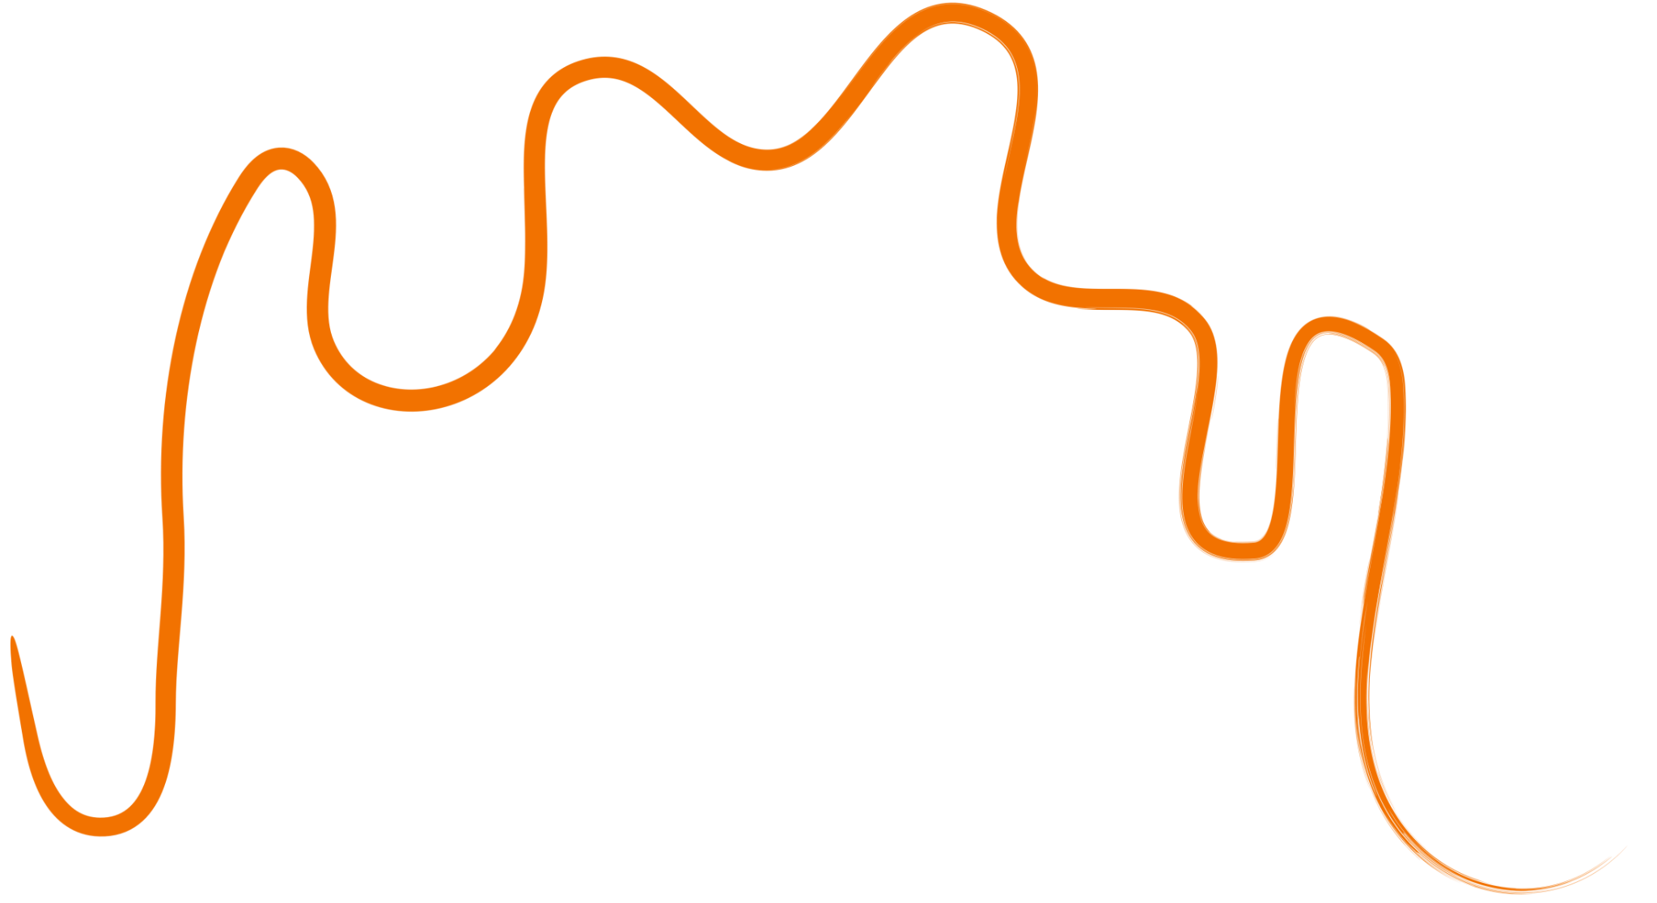
overfitting
degree
1
2
6
10
overfitting frequently takes place when the degree of a regression model is set too high
Notes:
In general, higher degrees makes the model more and more closely memorize the training data, but smaller degrees make the model bad at predicting. When you design your model, the degree you want is a parameter that you must choose carefully. (click)
If your data follows a predictable property, such as a projectile moving through the air, then you could choose a degree based on background knowledge that a projectile moves in a parabolic path.
But for data that’s more difficult to grasp, such as wine acidity, it’s usually best to just try a couple and see which ones work best.
TAKE QUESTIONS ABOUT OVERFITTING

Slide 15
How do we address under/overfitting?
Notes:
Let’s talk about some other ways we can address overfitting.

Slide 16
address overfitting
training data
Notes:
An easy way to address overfitting has to do with our data.

Slide 17
address overfitting
validation data
training data
test data
Notes:
We take a bit of our training data and we repurpose it for validation and testing.

Slide 18

address overfitting
Model Hasn’t Seen
Model Has Seen
validation data
training data
test data
we use validation and test sets, small subsets of data the model hasn’t seen before,
val point(s)!
Notes:
This is an important concept. The model frequently sees and learns using the training data, (click)
But it must not be able to see the validation or testing data. This way, we can accurately get a representation of the model’s actual accuracy on examples it HASN’T seen before and adjust model parameters as needed from there. (click)
If you think back to the red and green lines, that extra point we plotted is a validation point. During the actual validation process however, there's a lot more data points plotted instead of just one.

Slide 19


address overfitting
Model Hasn’t Seen
Model Has Seen
validation data
training data
wait but what’s the difference?
test data
Notes:
Ok wait but what’s the difference between the validation and testing data then?
The example with the red and green lines with the new datapoint is an example of how you would use validation data. It tells you when your model is overfitting and how you should adjust parameters while training.
But testing data, (click)

Slide 20
address overfitting
Whole Dataset
standardized for benchmarking!
test data
test sets are, unlike validation sets, usually set by the data creator as common, unseen benchmark data.
Notes:
Testing data is a small section of your whole dataset. You only deal with testing data once you are 100% done with your model. The purpose of testing data is for benchmarking: (click)
Comparing different models’ performance. The test set will always be consistent for the same dataset, usually, its even supplied separately to avoid confusion. (click)
When you want to test multiple models’ performance on a dataset, using a common set of benchmark data ensures that any improvements in accuracy are from the model improving and not just a difference in the testing material.

Slide 21
overfitting can be dangerous
data ethics
Notes:
Ok, so why do we care about overfitting so much? Overfitting creates models that might perform really well when training but when you deploy this supposedly amazing model in the real world, it can cause real damage.

Slide 22
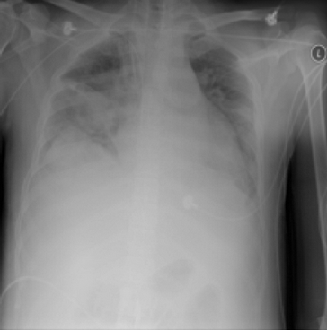
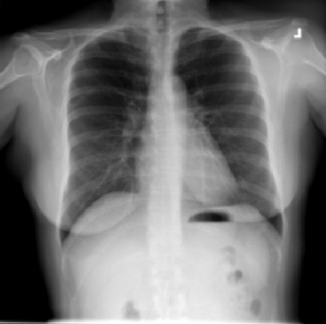
data ethics
which one has pneumonia?
Notes:
In this example, a model was trained to detect pneumonia in patients xrays. (click) (click)
In this case, the person on the left is the one who has pneumonia. However, the model decided with 90% certainty that it was the person on the right.
If we highlight the area that the model focused on the most, (click)…

Slide 23


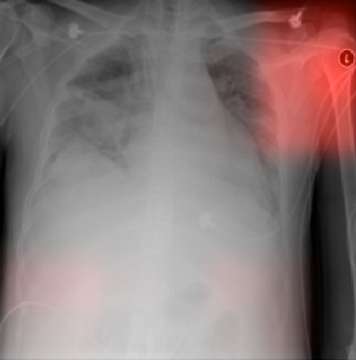
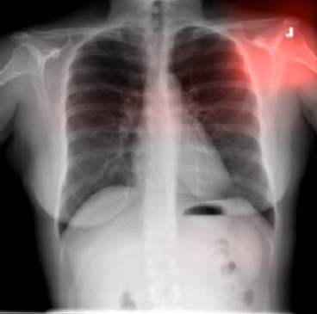
data ethics
different hospitals used different markers!
models, when not controlled for external factors, often overfit on easy targets
Notes:
it was really focused on the top right, the shoulder area.
So as a bit of context, the hospital that provided the pneumonia data for this model had a specific marker that it placed on all their xrays, and the hospital that provided the non-pneumonia data used a different one. (click) (click)
So, the model started overfitting to that one marker, because when it was training, whenever it saw that marker it would immediately mean that the patient had pneumonia. When a different one showed up, it would immediately mean that the patient didn’t have pneumonia.
TAKE QUESTIONS

Slide 24
Feature selection & Feature engineering

Slide 25
Motivation
Feature Selection
Performance could degrade when including input variables that are not relevant to the target variable.
Overfitting for tasks with a smaller # of samples
A large number of variables can be computationally expensive

Slide 26
Typical techniques
Feature Selection
Remove features with low variance (e.g., zero variance)
Remove features with low correlation based on statistical tests
Sequential feature selection
Forward: iteratively add the best new features
Backward: iteratively remove the least useful feature
https://scikit-learn.org/stable/modules/feature_selection.html

Slide 27
Feature Engineering
Feature Selection
Different from feature selection
Example: predict time-to-sell of a house
Input (features and label): square footage, lot size, transaction date, built date, and price
Engineered features could include
Cost per sq. ft
House age
Zip code
School rating
Data preprocessing (e.g., normalization, missing data) sometimes are also considered as feature engineering

Slide 28
Typical process
Feature Selection
Brainstorming features
Deciding what features to create
Creating features
Testing the impact of the identified features on the task
Improving your features if needed
Repeat

Slide 29
Features
Feature Selection
Feature selection
Feature engineering
PCA
Differences

Slide 30
Improving Outcome

Slide 31
Debugging a learning algorithm
Improving Outcome
A dataset
Applied a machine learning algorithm
Got a result, e.g., error rate 11%
Is this a good result?
Credit: Advanced Machine learning, Andrew Ng, Coursera, for the debugging discussion .

Slide 32
Establish a baseline
Improving Outcome
What is a reasonable level of error we can hope for?
Human level performance
Competing/existing algorithms
Educated guess based on experience
Additional baselines
Random guess
Simple heuristics

Slide 33
Bias/variance
Improving Outcome
 | Case 1 | Case 2 | Case 3
Baseline (e.g., human) | 10.6% | 10.6% | 10.6%
Training error | 11% | 15.5% | 11%
Validation error | 16% | 16% | 12%

Slide 34
Debugging
Improving Outcome
Bias: error from erroneous assumptions in the learning algorithm.
Variance: error from sensitivity to small fluctuations in the training set.
Q: how do they manifest?
Notes:
The bias error is an error from erroneous assumptions in the learning algorithm. High bias can cause an algorithm to miss the relevant relations between features and target outputs (underfitting).
The variance is an error from sensitivity to small fluctuations in the training set. High variance may result from an algorithm modeling the random noise in the training data (overfitting).

Slide 35
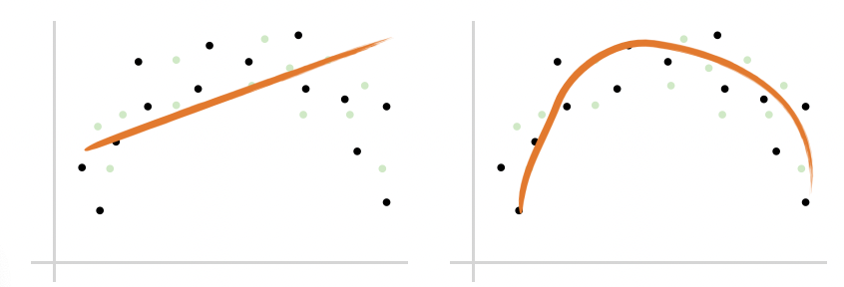
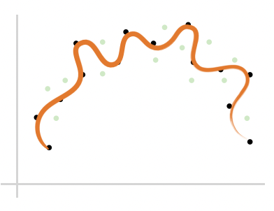
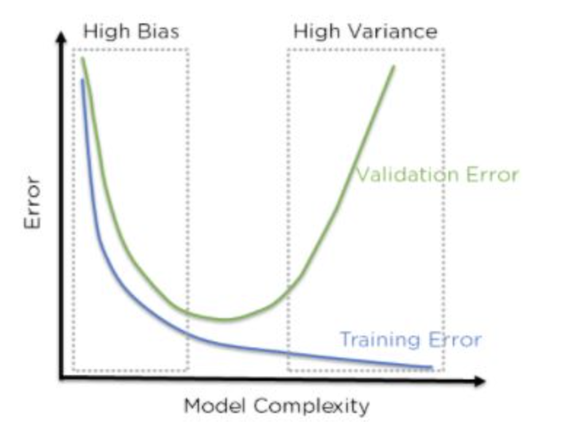
Debugging
Improving Outcome
High bias: training error high
High variance: validation error high
Notes:
The bias error is an error from erroneous assumptions in the learning algorithm. High bias can cause an algorithm to miss the relevant relations between features and target outputs (underfitting).
The variance is an error from sensitivity to small fluctuations in the training set. High variance may result from an algorithm modeling the random noise in the training data (overfitting).

Slide 36
Debugging
Improving Outcome
High bias: training error high
High variance: validation error high
What can we do?

Slide 37
Debugging
Improving Outcome
High bias: training error high
High variance: validation error high
Try getting additional features
Try adding polynomial features
Try decreasing regularization or use larger models
Get more training samples
Try smaller set of features
Try increasing regularization or use smaller models

Slide 38
Debugging
Improving Outcome
Try getting additional features (high bias)
Try adding polynomial features (high bias)
Try decreasing regularization or use larger models (high bias)
Get more training samples (fixes high variance)
Try smaller set of features (high variance)
Try increasing regularization or use smaller models (high variance)

Slide 39
Error analysis
Improving Outcome
Examine where the model went wrong
Categorize the errors
Focus on how to fix these errors (or most of them)

Slide 40
Example
Improving Outcome
Food spoilage prediction
Manually examine 100 examples where our model got wrong
Categorize them based on common traits
Southern CA: 21
Valley: 10
Raining weather: 50
Packaging: 5
More data and features for SoCal and raining days

Slide 41
A Real Example
Improving Outcome
Gait analysis to classify stroke patient in recovery vs. control
Notes:
Where we looked at what we got wrong and realized that those patients are the ones with other pathologies

Slide 42
When to Use Which Algorithm?
Improving Outcome
Start simple
Try the typical ones
Sklearn guideline

Slide 43
Potential Pitfalls

Slide 44
Things that can go wrong
Potential Pitfalls
Inconsistent preprocessing
Data leakage
Model is used on test data that has changed
Selecting appropriate metrics
Hidden confounders
Spurious correlations
Performance on subgroups may be missing
Data biases
Notes:
https://towardsdatascience.com/machine-learning-pitfalls-e54ac3edc25

Slide 45
Things that can go wrong
Potential Pitfalls
Inconsistent preprocessing (e.g., different scaling/normalization)
Data leakage (e.g., temporal or mixing subjects)
Model is used on test data that has changed
Selecting appropriate metrics (e.g., is 99% accuracy good enough?)
Hidden confounders (e.g., golf is correlated with heart attacks)
Spurious correlations (e.g., hospital ID on images)
Performance on subgroups may be missing
Data biases (e.g., AI recruiter)
Notes:
https://towardsdatascience.com/machine-learning-pitfalls-e54ac3edc25

Slide 46
ML Practices

Slide 47
Be Cautious
ML Practices
AI/ML is not a cure-all
“All models are wrong, some are useful.” –George Box
Understand your models, know the assumptions and limitations of the models
Is AI a hype or a GE?
Notes:
- If I flip a corn. Can you predict which side will be on top? No in general sense. Yes, if you can model everything that affect coin flip.
- Example: early AD prediction. Using EHR(I have to keep telling not going to be very good). Use Neuropsychological assessment.
Be aware of hypes. However, also recognize the power of ML. To me, knowing the basics of ML is a big enabler.

Slide 48
Typical steps to apply ML
ML Practices
Data preprocessing
Trying different ML algorithms
Training set, validation set, test set
Diagnostics
More training samples
Increase/decrease feature set
Increase/decrease regularization
Loop back

Slide 49
A ML Project
ML Practices
Why ML is a suitable approach
Do not use ML for the purpose of using ML
Evaluate existing approaches and room for improvement
Problem abstraction and formulation
Set appropriate goals
Model complexity, data availability, evaluation
Domain knowledge critical
Data collection and data cleaning
What, where, and how
ML algorithms
This is often the “easy” part
Evaluation, sanity check, interpretation
Iterate the process
Notes:
Problem abstraction and formulation can be important. In networks, the number of states can be extremely large is not carefully managed. This is a place where domain knowledge can be important. What are the important features, what are independent, what is the time granularity?
Consider the cellular QoE example (call complain). There are many different ways we could potentially formulate the problem: prediction-model + optimization, bandit algorithms, RL, deep RL. Data availability is a key factor. Learning complexity is another.
Set appropriate goals: ex: "Many studies applying machine learning to viticulture aim to optimize grape yields, but winemakers “want the right levels of sugar and acid, not just lots of big watery berries”.”

Slide 50
Characteristics of Good Problems
ML Practices
Existing solutions not satisfactory
Automate the process
Improve performance
Data availability: suitable data available or obtainable
Data quality and quantity
Can evaluate proposed approaches
Large complex problem beyond white-box modeling
Understanding complex venue and large data

Slide 51
Project Examples
Sanitation classification
Tomato processing loss prediction
Dietary recommendation
Help breeders to run more efficient and targeted breeding programs
Gait analysis
Biomarker identification
Disease outbreak prediction
Weather – outbreak spatial temporal analysis
Network traffic scheduling
Encrypted traffic classification
Traveling salesman

